Slide 1

Maine Education Financial System (MEFS)
Sometimes referred to as NEO Financial
May 20, 2025
Denise Towers
Maria Lidback
Ida Batista
School Finance Team

Slide 2

Reminders for FY25 4th Quarter Actual Financial and FY25 & FY26 Budget Uploads in MEFS
Submit 4th quarter electronic transfer of specifically coded actual revenue, actual expenditure, and actual balance sheet file records from the SAU accounting system to MEFS as soon as the quarter ends, beginning as early as July 1st or as soon as your reports are ready, to help avoid the year-end reporting rush.
Submit an annual electronic transfer of specifically coded budget revenue and expenditure file records from the SAU accounting system to MEFS. Due 30 days after budget passes or by August 15.
Upload budget backup documentation to MEFS. Due 30 days after budget passes or by August 15.
Submit the EF-M 46 budget assessment report if your district consists of more than one town. Due 30 days after budget passes or by August 15.

Slide 3

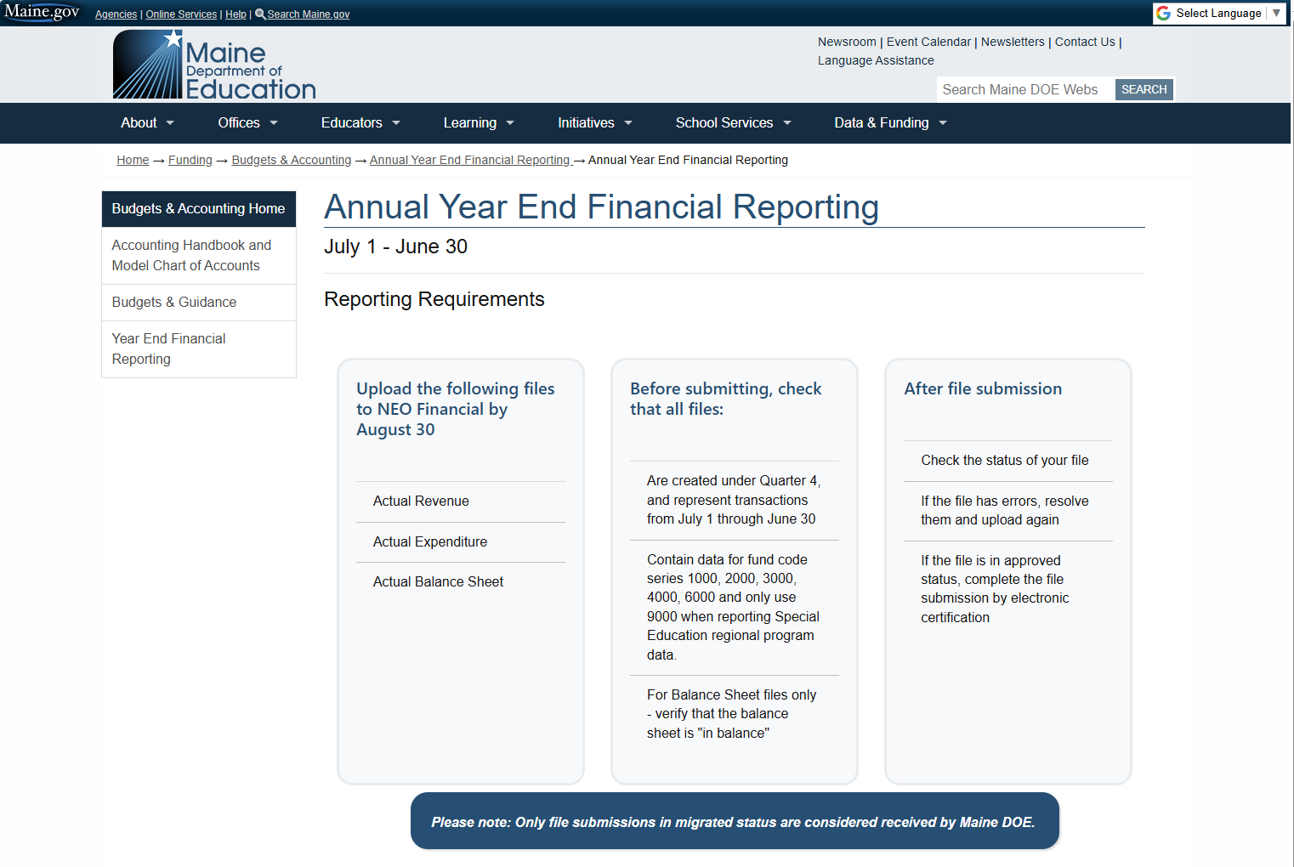
Annual Year End Financial Reporting

Slide 4

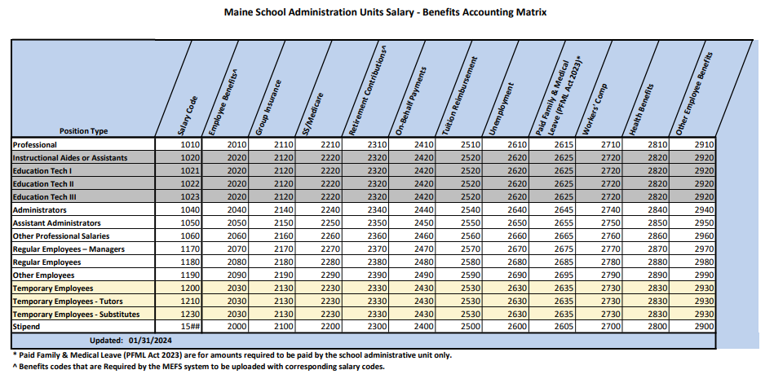
Salary Benefits Matrix
SALARY and BENEFITS coding must be exactly the same, except for the object code.

Slide 5

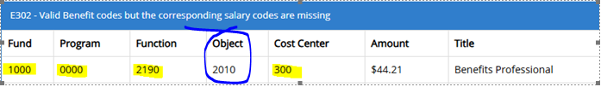
Example Error: Salary & Benefit Codes
MEFS Error – missing a salary line
MEFS Upload – Filtered coding, same coding string above.
Does anyone know which Object code is missing?

Slide 6

Important Announcements
Accounting Handbook Update is still in progress
Partial update (with latest coding changes) expected this week
Aimed at supporting smoother, more efficient year-end reporting.
Notification will be sent via listserv once posted on the website

Slide 7

Any Questions?
We welcome your feedback and are happy to answer any questions.
Feel free to ask!

