Slide 1


MAINE DEPARTMENT
OF EDUCATION
Fiscal Presentation: Transition of IDEA Part B, Chapter 619 Services from CDS to SAUs

Slide 2
Why?
Transition of child find and FAPE responsibilities to SAUs – Why? Why now?
Structure of existing system has been problematic:
  CDS responsible, but doesn’t operate or oversee general preschool programming, necessary for least restrictive environment (LRE)
  Requires significantly more admin and overhead costs, which drive up cost of serving the children
  Separate early childhood programs for children with disabilities, which contributes to high numbers of placements in special purpose private preschools and more restrictive placements

Slide 3




Legislation
LD 2214: An Act to Make Supplemental Appropriations and Allocations for the Expenditures of State Government, General Fund and Other Funds and to Change Certain Provisions of the Law Necessary to the Proper Operations of State Government for the Fiscal Years Ending June 30, 2024, and June 30, 2025
LD 2214 became Public Law 2023, Chapter 643, Part W

Slide 4
Enrollment Collection:
Enrollment counts will be collected Quarterly
  July 1
  October 1
  January 1
  April 1
Enrollments will be entered into the State Student Information System
Enrollments will also be collected on a spreadsheet initially until all systems are updated
Enrollments will include 3, 4, and 5 years olds in PreK with an IEP
Counts of students in Child Find with a signed parental consent to evaluate will be collected

Slide 5
Minimum Required Data Elements for Enrollment Record:
  SAU ID
  School ID
  State Student ID
  Last Name
  First Name
  Grade
  Sex
  Birthdate
  Language
  Race/Ethnicity
  Start Date
  Start Status
  Military Family
  FTE
  Fiscal Responsibility
  Resident Town
  Disability Code
  Special Education Setting
  Special Education Start date

Slide 6
Attendance for off-site students
For students who are not physically attending your school:
  Create a special classroom in your local SIS
  Record attendance as “present-remote”

Slide 7
Data & Financial Collection:
Early Childhood Special Education | Child Count | Detail Trial Balance Due Fund 2213 Revenue 3128 | Quarterly Upload to MEFS in NEO Due
Quarter 1 (July – Sept) | July 1 count Due July 7 | October 30 | October 30
Quarter 2 (Oct – Dec) | October 1 count Due October 7 | January 30 | January 30
Quarter 3 (Jan – March) | January 1 count Due January 7 | April 30 | April 30
Quarter 4 (Apr – June) | April 1 count Due April 7 | July 30 | July 30
Report to: | Jennifer Hopkins Paula Gravelle | Barbara McGowen Rebecca Mitchell | Upload to MEFS Maria Lidback
 | Jennifer.l.Hopkins@maine.gov Paula.b.gravelle@maine.gov | Barbara.a.mcgowen@maine.gov Rebecca.Mitchell@maine.gov | Maria.Lidback@maine.gov

Slide 8
Transition Status Update: Enrollment
SAU Cohort 1 | 1st Qtr. Count 7/1 |  | 2nd Qtr. Count 10/1 |  | 3rd QTR. Count 1/1 |  | 4th QTR. Count 4/1
 | IEPs | Child Find | IEPs | Child Find | IEPs | Child Find | IEPs | Child Find
Andover | 1 | 0 | 1 | 0 | 1 | 0 | 1 | 0
Beals | 1 | 0 | 2 | 0 | 2 | 1 | 2 | 2
Boothbay-Boothbay Harbor CSD | 1 | 0 | 1 | 0 | 3 | 2 | 3 | 0
Calais | 2 | 0 | 3 | 2 | 8 | 4 | 10 | 2
Great Salt Bay CSD | 8 | 1 | 11 | 0 | 11 | 0 | 11 | 3
Jonesport | 1 | 0 | 0 | 1 | 0 | 1 | 5 | 1
Kittery | 11 | 2 | 11 | 5 | 18 | 8 | 24 | 12
RSU 13 | 29 | 6 | 32 | 2 | 34 | 9 | 43 | 4
RSU 19 | 21 | 4 | 21 | 14 | 43 | 18 | 52 | 4
RSU 29/MSAD 29 | 16 | 3 | 17 | 4 | 20 | 2 | 22 | 6
RSU 35/MSAD 35 | 23 | 7 | 32 | 5 | 44 | 13 | 49 | 4
RSU 68/MSAD 68 | 11 | 3 | 19 | 4 | 24 | 1 | 26 | 3
RSU 80/MSAD 04 | 7 | 2 | 10 | 1 | 11 | 0 | 13 | 3
RSU 82/MSAD 12 | 0 | 0 | 0 | 0 | 0 | 0 | 0 | 0
St. George | 4 | 3 | 7 | 0 | 9 | 6 | 14 | 2
Veazie | 3 | 1 | 5 | 2 | 6 | 0 | 7 | 0
York | 14 | 4 | 17 | 4 | 23 | 10 | 27 | 6
Total Count | 153 | 36 | 189 | 44 | 257 | 75 | 309 | 52

Slide 9
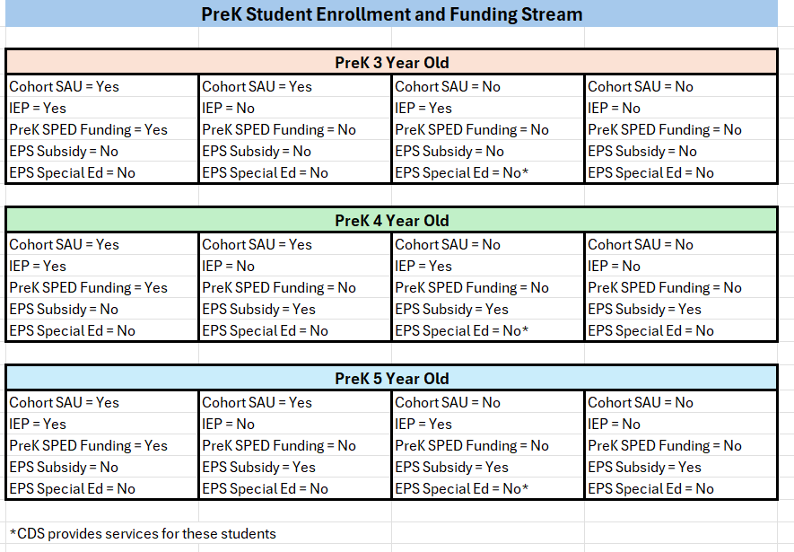
PreK Student Enrollment & Funding Stream

Slide 10

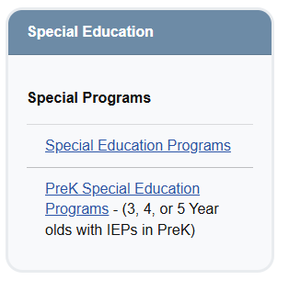
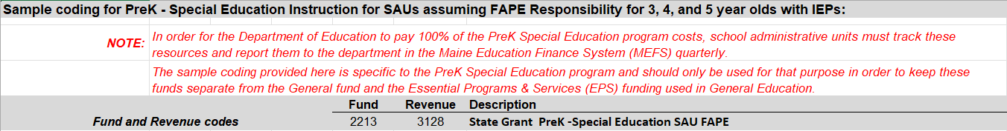
PreK Special Ed
Coding:
Fund = 2213
Revenue = 3128
https://www.maine.gov/doe/funding/accounting/handbook
Use this chart of accounts for K-12 Special Education
Part of EPS Allocation with State & Local Share
Use this chart of accounts for PreK Special Education
Separate funding source – 100% State Funded

Slide 11
Quarterly Payments:
Payments will be calculated based on quarterly count collections.
Payments will be made each quarter.
1st quarterly payment will be based on July 1 actual counts or estimate counts if it is the SAUs first year in the Early Childhood Special Education (ECSE) Program.
2nd quarterly payment may be more or less than the 1st quarter based on actual counts.
3rd and 4th quarterly payments will never go below the amount calculated after the 2nd quarter collection but may go up if counts are higher.
Notes:
Megan

Slide 12
Payment Calculation:
Payments will be calculated using each School Administrative Units (SAUs) Elementary EPS rate and Economic Disadvantaged Percentage from that years ED 279 report.
General Education/FAPE Calculation =
  Basic Count = Count x Elementary EPS Rate
  Disadvantaged = Count x Disadvantaged % x EPS Rate x Disadvantaged Weight .15
  Assessment Amount = Count x Per Pupil $55.00
  Technology Amount = Count x Per Pupil $120.00
  PreK Additional = Count x EPS Rate x PreK Weight .10
  Additional Disadvantaged = Count x Disadvantaged % x EPS Rate x Disadvantaged Weight .05
Special Education Calculation =
  Count x EPS Rate x 1.5 weight
Child Find Calculation =
  Count x $1,000
Notes:
Megan

Slide 13


https://www.maine.gov/doe/cds/earlychildhoodspecialeducation

