Slide 1
SPPS Director’s Meeting
12-13-23
For more information contact: Titus O’Rourke & Leora Byras titus.orourke@maine.gov leora.byras@maine.gov

Slide 2
AGENDA
EST Committee: what is it and how can your students be involved?
Youth Summit Steering Committee
Power Hour Series and Newsletter
How can we support you?
Notes:
COP – No one place has to reinvent the place -sharing of best practices and peer to peer support

Slide 3
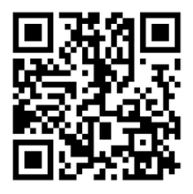
Executive Student Transition Committee
Help lead youth efforts to support students transitioning from high school into adulthood.
Notes:
Requiring Maine public college campuses to offer accommodations to young people whose severe disabilities prevent them from earning a standard high school diploma, allowing them to take classes as nondegree-seeking students and join extracurricular activities alongside their peers.

Slide 4
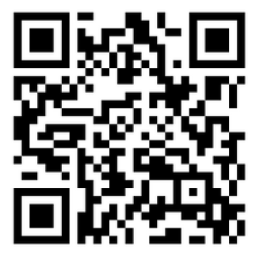
Youth Summit Steering Committee
Economic Inclusion
“I Belong”
-Compensated Opportunity
-Time commitment 4 hours per month via Zoom with at least 2 in person meetings/events
Summit: 5/30/24
Rain date: 6/6/24
Location: TBD
Notes:
Requiring Maine public college campuses to offer accommodations to young people whose severe disabilities prevent them from earning a standard high school diploma, allowing them to take classes as nondegree-seeking students and join extracurricular activities alongside their peers.

Slide 5
Transition PD’s, Resources & Opportunities
Providing opportunities for Maine’s transition champions and leaders to grapple with, actuate strategies and support our scholars' diverse needs, by expounding student centric transition pathways to post-secondary opportunities.
Tuesday at 3 to 4 pm.
https://www.maine.gov/doe/calendar/
We are also available to answer questions as they come up, offer support, and/or work with you to design PD that fits your Team.

Slide 6
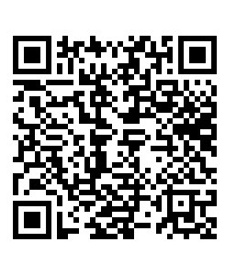
Please take a moment to scan the QR code to help us design PD that will be useful to you!
This Photo by Unknown Author is licensed under CC BY-NC-ND

Slide 7
titus.orourke@maine.gov or call 207 215 6303
Thank You!
For more information contact
Titus O’Rourke
Leora Byras
leora.byras@maine.gov or call 207 624 6618

